Slide 1
Social Engineering
Social engineering occurs when a cybercriminal creates a social situation that can lead to a potential victim dropping their guard. It involves the manipulation of people into breaking their normal security procedures and not following best practice. There are five types of threat that commonly exist:

Slide 2
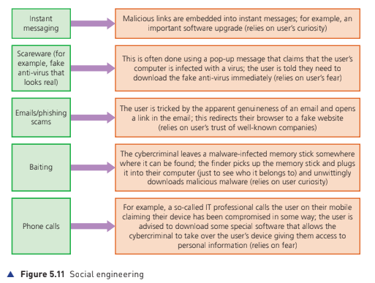

Slide 3
Keeping data safe from security threats
Access Levels
In many computer systems, user accounts control a user’s rights. This often involves having different levels of access for different people. For example, in a hospital it would not be appropriate for a cleaner to have access to medical data about a patient. However, a consultant would need access to this vital data. Therefore, most systems have a hierarchy of access levels depending on a person’s level of security; this is usually achieved using a user name and password

Slide 4
Anti malware
The two most common types of anti-malware are anti-virus and anti-spyware.
Anti Virus Software - software that quarantines and deletes files or programs infected by a computer virus; the software can run in the background or be initiated by the user
Also detects unauthorised alterations to a website address and warn the user of the potential risks.
https://www.youtube.com/watch?v=jW626WMWNAE

Slide 5
Anti-spyware
Anti-spyware software detects and removes spyware programs installed illegally on a user’s computer system. The software is based on one of the following methods:
» rules – in this case, the software looks for typical features which are usually associated with spyware thus identifying any potential security issues
» file structures – in this case, there are certain file structures associated with potential spyware which allows them to be identified by the software.

Slide 6
Authentication
Authentication refers to the ability of a user to prove who they are. There are three common factors used in authentication:
» something you know (for example, a password or PIN code)
» something you have (for example, a mobile phone or tablet)
» something which is unique to you (for example, biometrics).

Slide 7
Biometrics
Biometrics can be used in much the same way as passwords as a way of identifying a user. Biometrics relies on certain unique characteristics of human beings; examples include:
» fingerprint scans
» retina scans
» face recognition
» voice recognition.

Slide 8
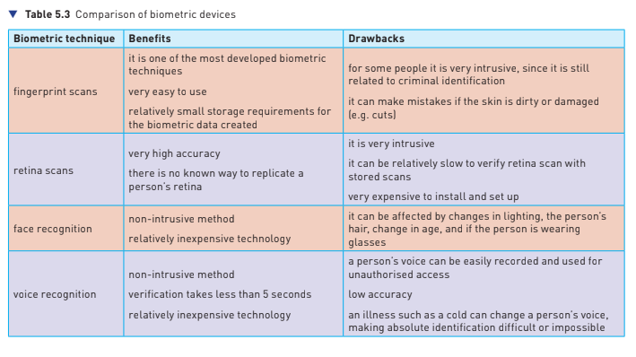

Slide 9
2 Step Verification
Two-step verification requires two methods of authentication to verify who a user is. It is used predominantly when a user makes an online purchase using a credit/debit card as payment method. For example, suppose Kate wishes to buy a new camera from a website. She logs into the website using her computer. This requires her to enter a user name and a password, which is step 1 of the authentication process. To improve security, an eight-digit PIN (called a one-time pass code) is sent back to her either in an email or as a text message to her mobile phone (the mobile phone has already been registered by Kate on the website as the second stage of the authentication process). Kate now enters this eight-digit PIN into her computer and she is now authorised to buy the camera.

Slide 10
Typo Squatting
Misspelling of domain names in a link are very common errors found in emails
sent by scammers and fraudsters. The authors of this book have seen these
incorrect spellings:
www.gougle.com
www.amozon.com
This is known as typo squatting where names close to the genuine names are
used to fool you.

Slide 11
Firewall
Firewalls
A firewall can be either software or hardware. It sits between the user’s computer and an external network (for example, the internet) and filters information in and out of the computer. This allows the user to decide whether or not to allow communication with an external source and it also warns a user that an external source is trying to access their computer. Firewalls are the primary defence to any computer system to help protect it from hacking, malware (viruses and spyware), phishing and pharming.

Slide 12

SSL
Secure Sockets Layer (SSL) is a type of protocol – a set of rules used by computers to communicate with each other across a network. This allows data to be sent and received securely over the internet. When a user logs onto a website, SSL encrypts the data – only the user’s computer and the web server are able to make sense of what is being transmitted. A user will know if SSL is being applied when they see https or the small padlock in the status bar at the top of the screen.
The address window in the browser when https protocol is being applied, rather than just http protocol, is quite different:

